Slide 1
Kruskal’s MST and Find-Union Data Structure
CS4102
Tom Horton and Mark Floryan

Slide 2
Topics

Slide 3
Topics in this slide-deck:
Motivating Problem: Minimum Spanning Trees
This is a graph problem, and you’ve seen it
One solution
Kruskal’s Algorithm (Uses a find-union structure)
Define and design the find-union to support Kruskal’s Algorithm
Will require some clever implementation details

Slide 4
Minimum Spanning Trees

Slide 5
Spanning Tree
A spanning tree of a graph G is a subgraph of G that contains every vertex in G and is also a tree (i.e., it has no cycles)
All connected graphs have spanning tree(s)
All spanning trees have the same number of nodes (all of them)
You can construct a spanning tree by arbitrarily remove edges from cycles

Slide 6
Spanning Tree: Example
Original Graph:
Possible spanning trees:

Slide 7
Spanning Tree: Example (almost)

Slide 8
Minimum Spanning Tree
Just constructing any spanning tree is simple
Suppose edges have costs!
Cost of building tracks between two stations
Length of wire between boxes in a house
Each spanning tree has a different total cost (sum of edges included in tree)
The Minimum Spanning Tree is the spanning tree with lowest overall cost

Slide 9
Minimum Spanning Tree
Given a connected and undirected graph G=(V, E)
Find a graph G’ = (V, E’) such that:
E’ is a subset of E
|E’| = |V| - 1
G’ is connected (assuming G was connected)
Sum of cost of edges in E’ is minimum
G’ is then the minimum spanning tree

Slide 10
Kruskal’s Algorithm

Slide 11
Kruskal’s MST Algorithm
Prim’s approach:
Build one tree. Make the one tree bigger and as good as it can be.
Kruskal’s approach
Choose the best edge possible: smallest weight
Not one tree – maintain a forest!
Each edge added will connect two trees. Can’t form a cycle in a tree!
After adding n-1 edges, you have one tree, the MST

Slide 12
Kruskal’s MST Algorithm
Idea: Grow a forest out of edges that do not create a cycle. Pick an edge with the smallest weight.
G=(V,E)
v

Slide 13
MST
2
v₂
v₁
4
1
3
10
v₃
2
v₄
7
v₅
5
8
4
6
v₆
1
v₇

Slide 14
MST
2
v₂
v₁
4
1
3
10
v₃
2
v₄
7
v₅
5
8
4
6
v₆
1
v₇
v₁
v₂
v₃
v₄
v₅
v₇
v₆

Slide 15
Kruskal code
void Graph::kruskal(){
int edgesAccepted = 0;
DisjSet s(NUM_VERTICES);
while (edgesAccepted < NUM_VERTICES – 1){
e = smallest weight edge not deleted yet;
// edge e = (u, v)
uset = s.find(u);
vset = s.find(v);
if (uset != vset){
edgesAccepted++;
s.unionSets(uset, vset);
}
}
}
|E| heap ops
2|E| finds
|V| unions

Slide 16
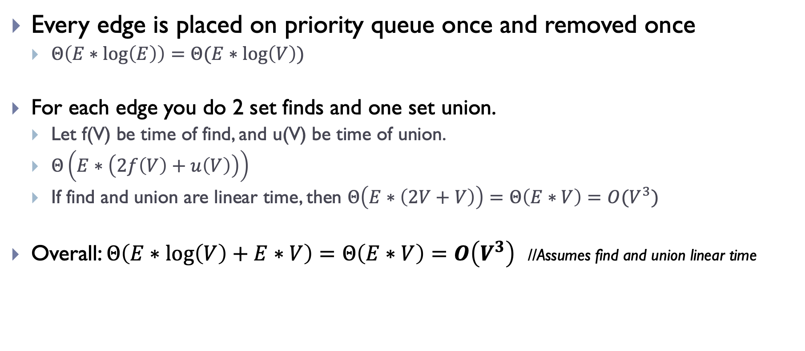
Runtime of Kruskal’s
Every edge is placed on priority queue once and removed once
$Θ\left(E∗\log\left(E\right)\right)=Θ(E∗\log\left(V\right))$
For each edge you do 2 set finds and one set union.
Let f(V) be time of find, and u(V) be time of union.
$Θ\left(E∗\left(2f\left(V\right)+u\left(V\right)\right)\right)$
If find and union are linear time, then $Θ\left(E∗\left(2V+V\right)\right)=Θ\left(E∗V\right)=O(V^{3})$
Overall: $Θ\left(E∗\log\left(V\right)+E∗V\right)=Θ\left(E∗V\right)=O\left(V^{3}\right)$ //Assumes find and union linear time

Slide 17
Strategy for Kruskal’s
EL = sorted set of edges ascending by weight
Foreach edge e in EL
T1 = tree for head(e)
T2 = tree for tail(e)
If (T1 != T2)
add e to the output (the MST)
Combine trees T1 and T2
Seems simple, no?
But, how do you keep track of what trees a node is in?
Trees are sets. Need to findset(v) and “union” two sets

Slide 18
Find-Union Data Structure

Slide 19
Union/Find and Disjoint Sets
Needs to support the following operations
void makeSet(int n) //construct n independent sets
int findSet(int i) //given i, which set does i belong to?
void union(int i, int j) //merge sets containing i and j

Slide 20
Union/Find and Disjoint Sets
Needs to support the following operations
void makeSet(int n) //construct n independent sets
Solution:
Store as array of size n. Each location stores label for that set.
0 1 2 3 4 5 6 7
0 1 2 3 4 5 6 7

Slide 21
Union/Find and Disjoint Sets
Needs to support the following operations
int findSet(int i) //given i, which set does i belong to?
Solution: Trace around array until we find place where index and contents match
Start at index i and repeat:
If a[i] == i then return i
Else set i = a[i]
0 1 2 3 4 5 6 7
0 1 2 3 4 5 6 7

Slide 22
Union/Find and Disjoint Sets
Needs to support the following operations
void union(int i, int j) //merge sets i and j
Solution: find label for each set (call find() method), then set one label to point to other
Label1 = find(i); Label2 = find(j)
a[Label1] = Label2 //OR a[Label2] = Label1
0 1 2 3 4 5 6 7
0 1 2 3 4 5 6 7

Slide 23
Union/Find and Disjoint Sets
Example:
merge(4,5)
merge(6,7)
merge(1,2)
merge(5,6)
find(1); find(4); find(6)
0 1 2 3 4 5 6 7
0 1 2 3 4 5 6 7

Slide 24
Union/Find and Disjoint Sets
Time-complexity if where n is size of array?
makeSet()
Linear: just create array and fill it with values
find()
Linear if have to trace a long way to get to label
Constant if lucky and label given as input
union()
Constant to change the label BUT…
Could be linear to find the two labels first.

Slide 25
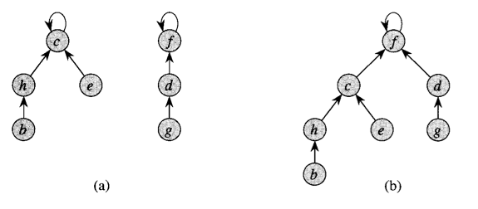
Optimization 1: Union by rank

Slide 26
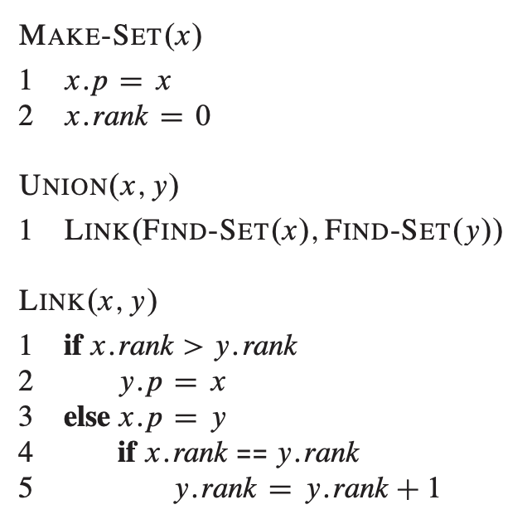
Optimization 1: Union by rank
Easy to implement!!

Slide 27
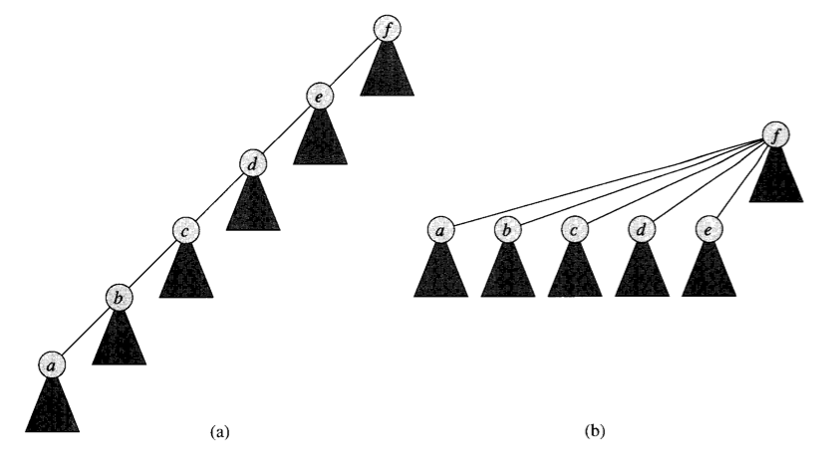
Optimization 2: Path Compression

Slide 28
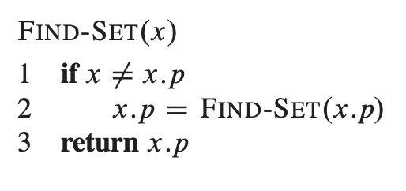
Optimization 2: Path Compression
Also easy to implement

Slide 29
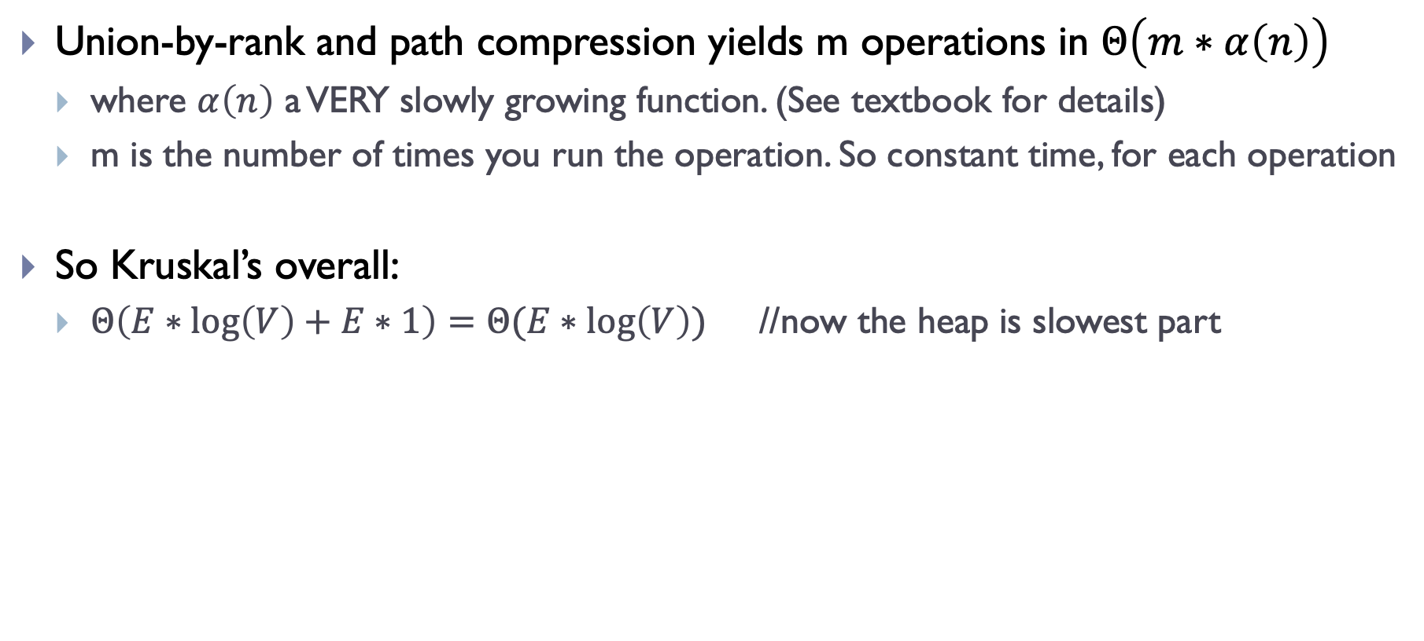
Complexity for Kruskal’s
Union-by-rank and path compression yields m operations in $Θ\left(m∗α\left(n\right)\right)$
where $α\left(n\right)$ a VERY slowly growing function. (See textbook for details)
m is the number of times you run the operation. So constant time, for each operation
So Kruskal’s overall:
$Θ\left(E∗\log\left(V\right)+E∗1\right)=Θ(E∗\log\left(V\right))$ //now the heap is slowest part

Slide 30
Summary

Slide 31
What did we learn?
Minimum Spanning Trees
Review!
Kruskal’s Algorithm
Review again!
Find-union
How to implement
How to optimize
How it affects runtime of Kruskal’s algorithm.

